Slide 1
Needle-free
Immunization
GROUP 5
Wanghan Sun, Ruslan Shupanov,
Xinya Zheng, Ling Ji, Edward Small
1

Slide 2
1
INTRODUCTION
2
Wanghan Sun

Slide 3
Background
What is the final depth of the particles being blown into the skin?
Main purpose
Analyze the behavior of the particles as they move through the cortex and to calculate how deep in the cortex the particles will end up resting.
PROBLEM
3

Slide 4
2
PHYSICAL
MODEL
4
Ling Ji

Slide 5
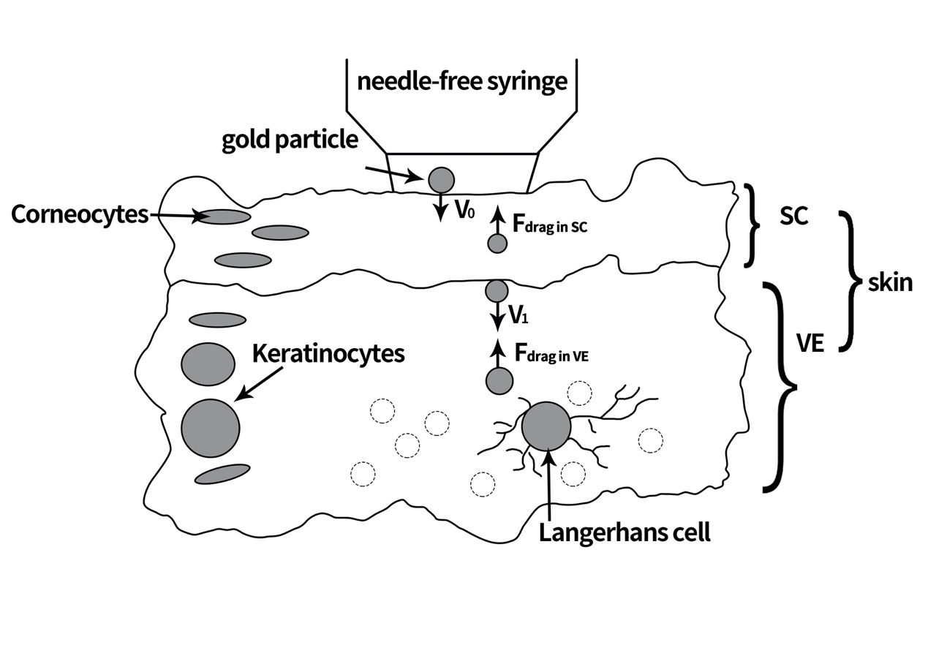


The motion of the particles
In the skin
THE STRUCTURE
Stratum corneum (SC)
Viable epidermis (VE)
Langerhans cell (LC)
Gold particle
$$F_{drag}=\frac{1}{2}c_{D}ρ_{s}Av^{2}+cAσ_{Y}$$
$ρ_{s}$ is the density of the skin
(treated as a fluid with constant properties)
$A$ is the cross-sectional area of the particle
$v$ is its velocity
$c_{D}$ is an empirical drag coefficient
$σ_{Y}$ yield stress of the material.
C yield constant
SC
VE
5

Slide 6
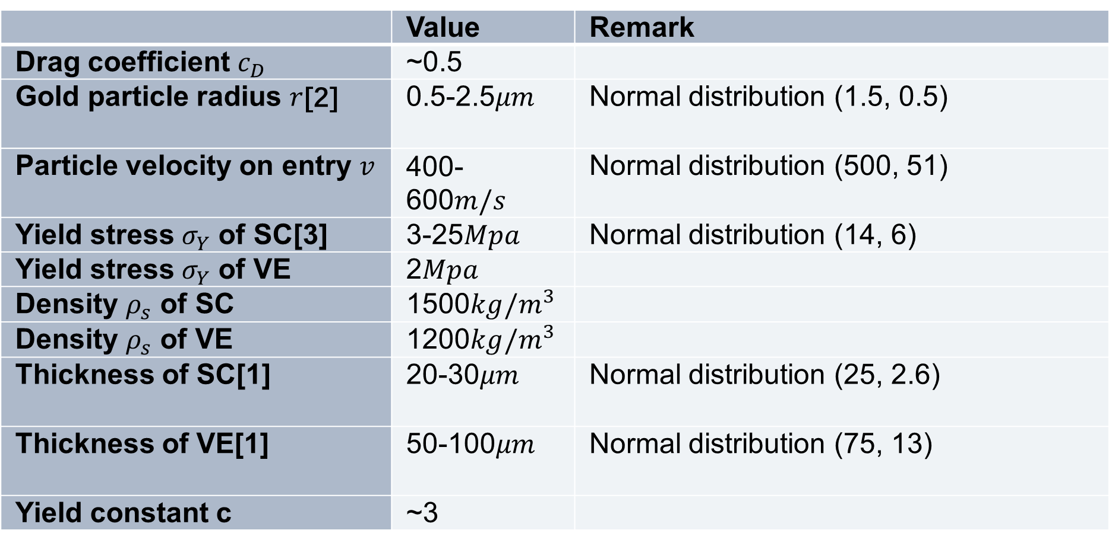
Relevant parameters to be used in the model
*see reference
 | Value | Remark
Drag coefficient $c_{D}$ | ~0.5
Gold particle radius $r$[2] | 0.5-2.5$μm$ | Normal distribution (1.5, 0.5)
Particle velocity on entry $v$ | 400-600$m/s$ | Normal distribution (500, 51)
Yield stress $σ_{Y}$ of SC[3] | 3-25$Mpa$ | Normal distribution (14, 6)
Yield stress $σ_{Y}$ of VE | 2$Mpa$
Density $ρ_{s}$ of SC | 1500$kg/m^{3}$
Density $ρ_{s}$ of VE | 1200$kg/m^{3}$
Thickness of SC[1] | 20-30$μm$ | Normal distribution (25, 2.6)
Thickness of VE[1] | 50-100$μm$ | Normal distribution (75, 13)
Yield constant c | ~3
6

Slide 7
3
ANALYTICAL
SOLUTION
7
Ruslan Shupanov

Slide 8
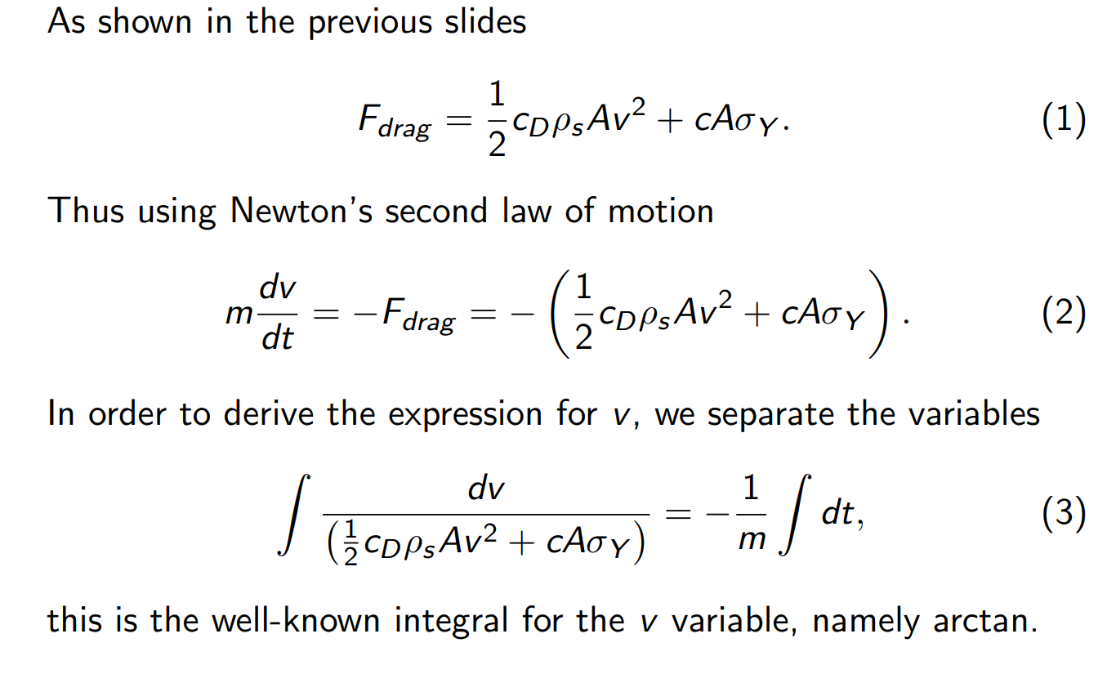
8

Slide 9
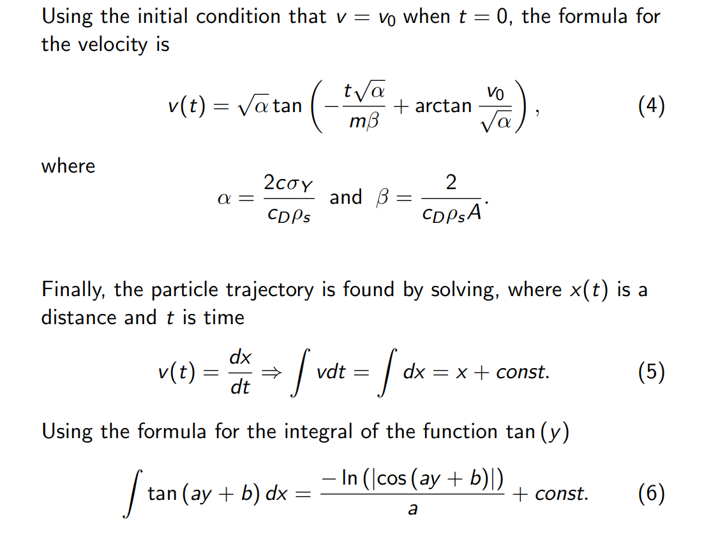
9

Slide 10
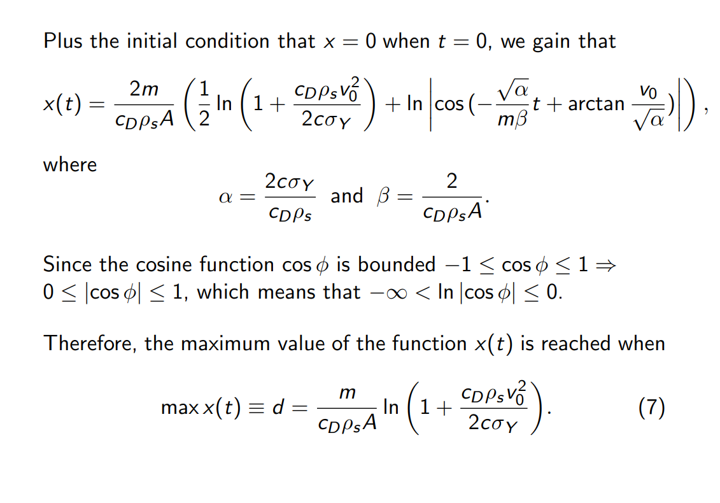
10

Slide 11
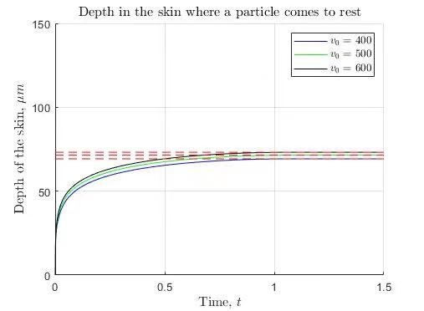
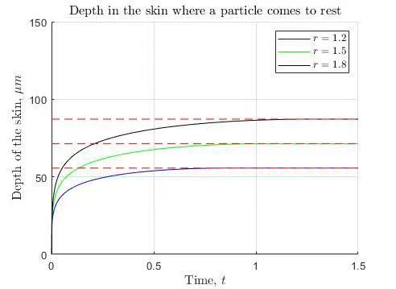
Some results
11

Slide 12
4
NUMERICAL
SOLUTION
12
Edward Small

Slide 13
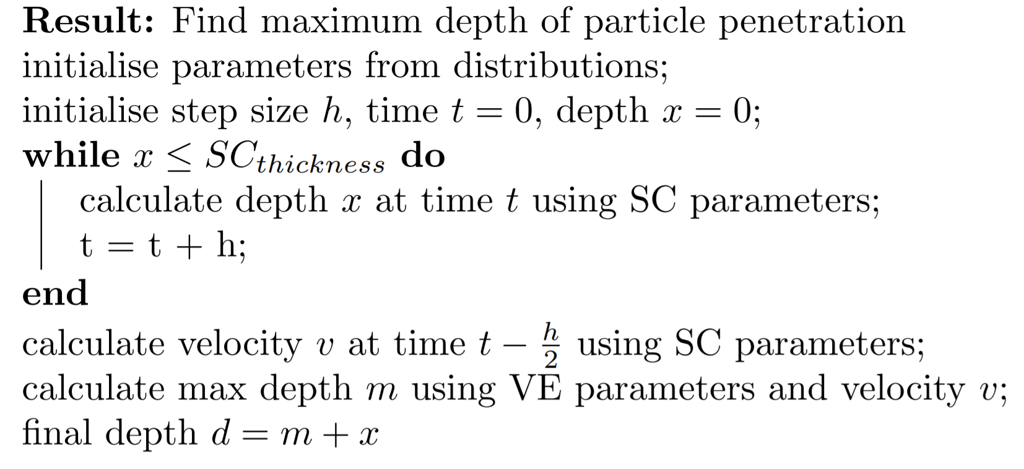
Algorithm
13

Slide 14
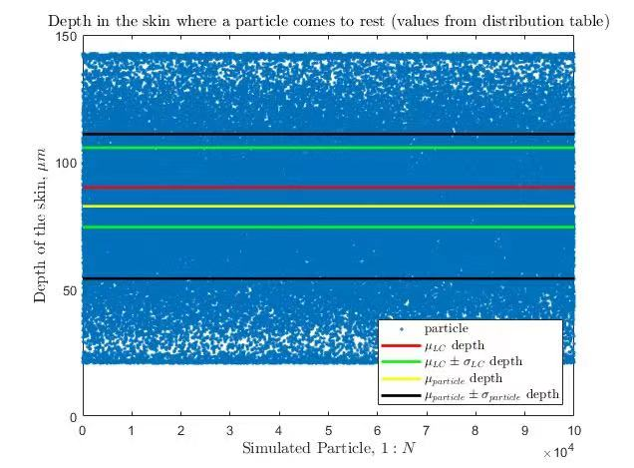
Numerical results using distribution table
1
27.17% of cells end in the LC layer or go beyond it.
2
Most particles fall short
14

Slide 15
The effectiveness of the method
Assumption
The LCs have a radius R = 4um and particles have a radius R1 = 1.5um (the mean).
A gold particle that has landed in the LC layer has an equal probability of landing anywhere in the LC layer.
Hitting an LC does not remove it from the system
R
R1
Viable area to consider an LC cell "hit" is
π(R + 2×R1)^2 = 0.000154mm^2
1000 LC cells per mm^2, so 15.4% of the area is considered "successful hit".
15

Slide 16
Each particle has a 84.6% chance of missing.
For half the particles to have a 95% chance of being hit, we require
0.846^(n/2) = 0.05
n/2= 17.91, so require approximately n=8.955 particles per LC cell to land in the LC zone.
Need 8955 particles in LC zone. With a 27.17% rate of landing in the zone, we require approximately 32959 particles to be fired
Under the assumption, do some calculations:
What Can we change?
16

Slide 17
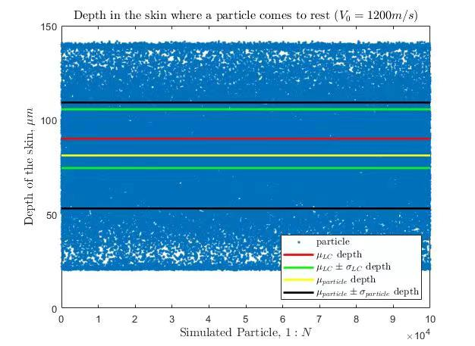
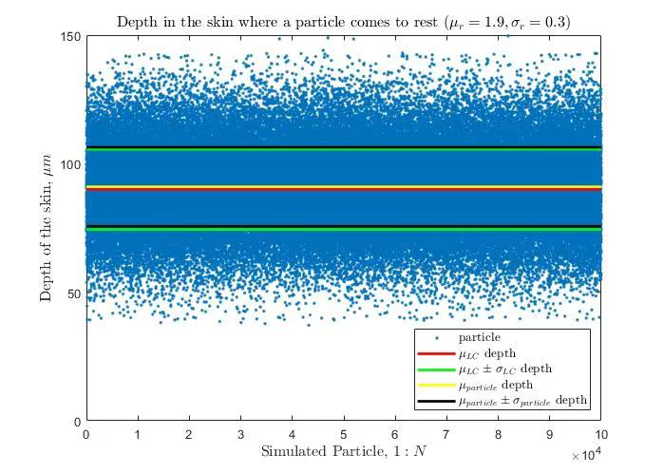

Increasing initial velocity
Changing mean particle radius and standard deviation
Depth in the skin where a particle comes to rest(V0$=1200m/s)$
Good=41.39%
Depth in the skin where a particle comes to rest($μ_{r}=1.9,σ_{r}=0.3)$
Good=61.07%
Changing radius mean and SD would reduce particles needed from 32959 to approximately 14663, so only need 44.49% of particles
17

Slide 18
5
EXPANSION ON
THE MODEL
18
Xinya Zheng

Slide 19
Problems in our model
We don’t consider the fluid dynamics
The diffusion of particles through the skin is not taken into account
We assume the particles don’t break up in anyway
We don’t consider too much of biological modelling
Probability calculation needs to be refined more accurate
Hitting an LC does not remove it from the system( several particles will hit the same LC)
Particles and cells are three-dimensional, and the two-dimensional model has its limitations
A simple thought of the improvement of the model
19

Slide 20
3-D model
These particles have random radius and velocity (and other quantities, like position)
The initial position（x0,y0,z0）
The random radius r0
The random velocity v0
The initial number of particles N0
Use the two-layers model to calculate x(t)(final depth)
The finial position（x0,y0,z0+X（t））
The finial number of particles N
（we can use the position value to see how these particles distributed in the LC layer, generally.)
20

Slide 21
Assumption
From some research, we suppose that “LCs form a monolayer network of cells distributed evenly throughout the suprabasal layers of the epidermis”
(*see reference [4])
Hypothesis
In the small space around the one Langerhans cell, if the concentration of particles exceeds a certain value, the Langerhans cell can be considered to have been hit successfully (Successful absorption).
Uniform distribution
(Then we can also have the position of the LCs)
In the 2D model, the particles need to reach the depth of the Langerhans cell to hit the cell correctly, while in the 3D model, the concentration of the particles in the space around the Langerhans cell is used as a parameter for probability calculation.
21

Slide 22
Reference
[1]Egawa, M. et al.(2007) ‘In vivo Estimation of Stratum Corneum Thickness from Water Concentration Profiles Obtained with Raman Spectroscopy’,Actadermato-venereologica87, pp. 4–8.
[2]He, L. et al.(2013) ‘Statistics of multiple-scatterer induced frequency split-ting in whispering gallery microresonators and microlasers’,New Journal ofPhysics15
[3]Maria, F. L. et al.(2015) ‘A mechanistic insight into the mechanical role of the stratum corneum during stretching and compression of the skin’,Journal of the Mechanical Behavior of Biomedical Materials49, pp. 197–219
[4]YU, R., ABRAMS, D., ALAIBAC, M. and CHU, A. (1994), Morphological and quantitative analyses of normal epidermal Langerhans cells using confocal scanning laser microscopy. British Journal of Dermatology, 131: 843-848.
Code link
https://github.com/Teddyzander/transferable_skills/
22

Slide 23
THANK YOU FOR LISTENING!
ANY QUESTIONS?
23

